Slide 1
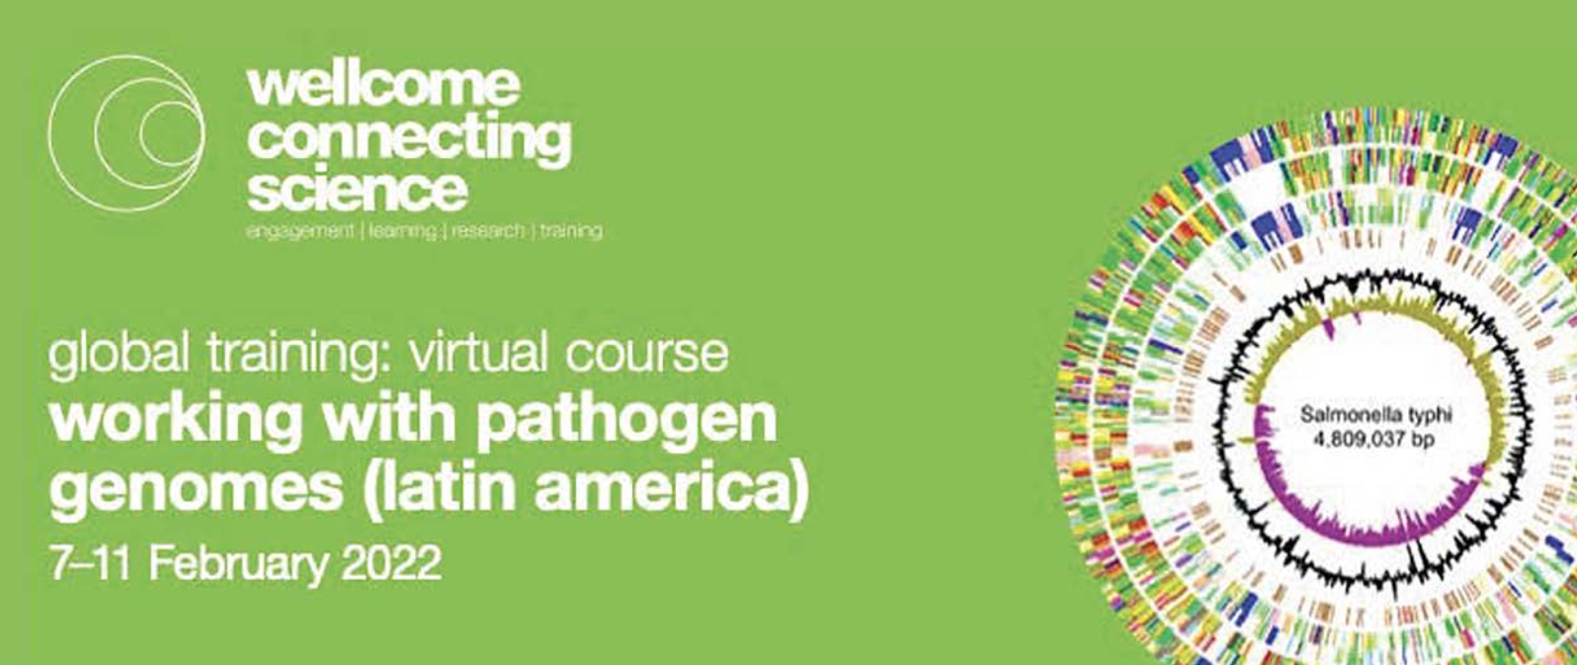
Module 6 Transcriptome analysis using RNA-seq
Pepe Tort & Flor Diaz-Viraque
FMed-Udelar & IPasteur

Slide 2
outline
WWPG 22
RNA-seq background
Mapping to the genome (HISAT2 and Artemis)
Mapping to the transcriptome and counting reads (Kallisto)
Read count normalization
Differential expression (Sleuth)
What to do with a gene list
Today´s exercise

Slide 3
Different cells express different genes
WWPG 22
RNA-seq background

Slide 4
Gene expression
WWPG 22
RNA-seq background

Slide 5
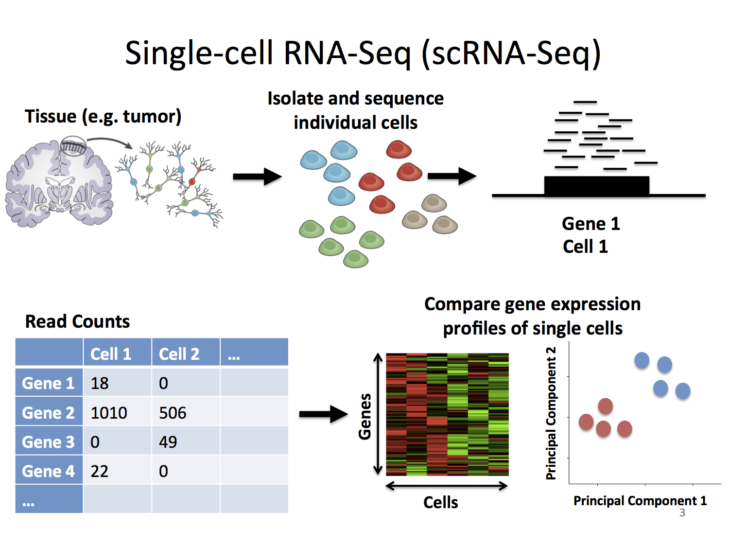
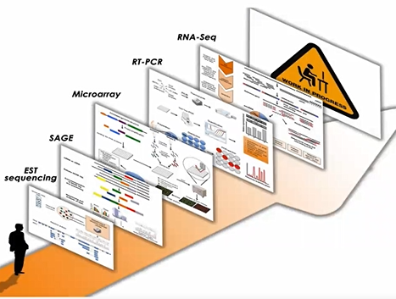
Approaches to measure RNA abundance
WWPG 22
Low to moderate throughput
De novo or reference based
Single cell RNAseq is possible
Moderate to high throughput approaches
Requires reference genome
Large amounts of RNA
RNA-seq background

Slide 6
RNA sequencing
WWPG 22
RNA-seq background

Slide 7
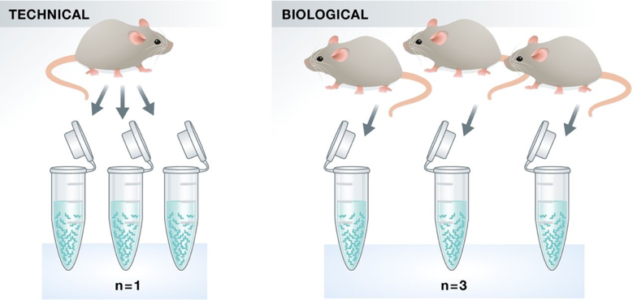
notes on experimental design
WWPG 22
Replicates
Sequencing depth
Since generally the idea is quantifying differential expression:
Relevant biological replicates are key to reliable results
Technical replicates are not generally required, but try to arrange samples on plates to minimise potential problems
How many reads to discover low expression transcripts?
Increased sequencing depth improves low copy number transcript detection
Practical considerations e.g. amount of data on one lane, number of barcodes/tags
# reads * read length
Estimated length of exome
RNA-seq background

Slide 8
RNAseq analysis strategies
WWPG 22
No reference genome
To identify novel transcripts/isoforms
Identify fusion reads
Quantify differential expression
Faster cause less target sequences
Improved algorithms
Identify novel transcripts/isoforms
Update genoma annotation
Differential expression
RNA-seq background

Slide 9
RNAseq analysis strategies
WWPG 22
Mapping to the transcriptome and counting reads (Kallisto)

Slide 10
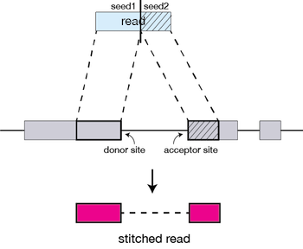
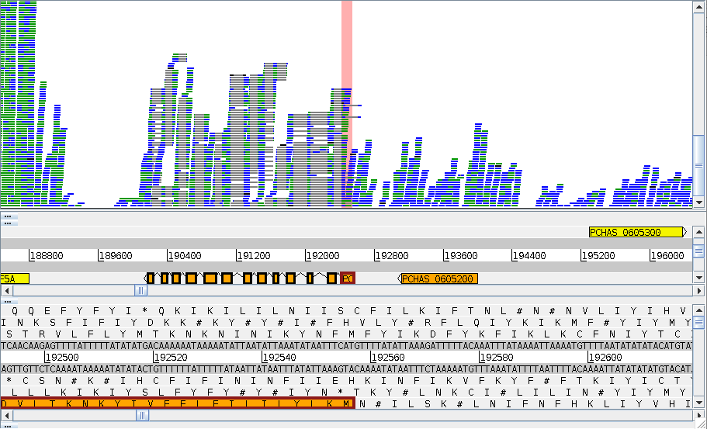
Mapping RNA-seq reads to the genome (HISAT2)
WWPG 22
Eukaryotic genes have introns, which are not present in mature mRNA so special (splice aware) mapping algorithms are required
HISAT2 is only one such algorithm, but is accurate, fast and easy to use
Steps
index ref.
Map reads 2 ref
Convert mapping data
Sort & Index mapped
visualize
Mapping to the genome (HISAT2 and Artemis)

Slide 11
Visualizing on Artemis
WWPG 22
Mapping to the genome (HISAT2 and Artemis)

Slide 12
Visualizing on Artemis
WWPG 22
Mapping to the genome (HISAT2 and Artemis)

Slide 13
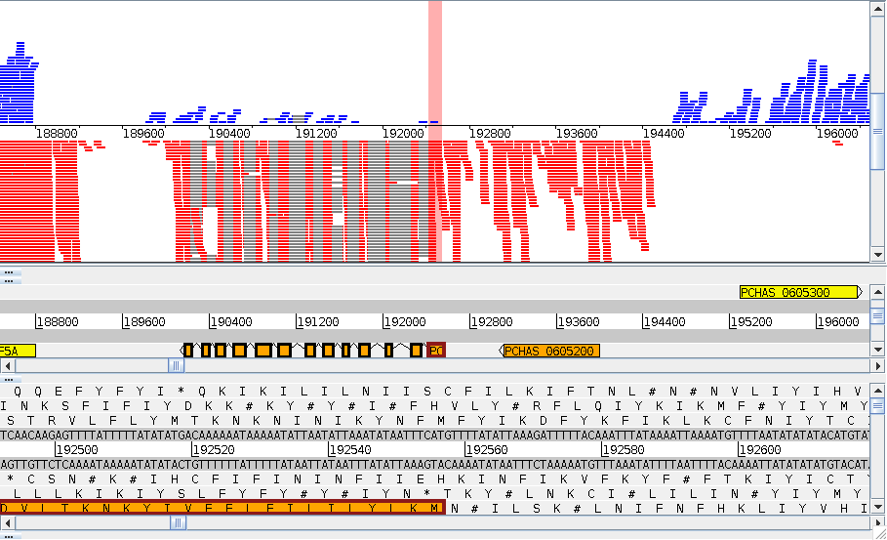
Visualizing on Artemis
WWPG 22
Mapping to the genome (HISAT2 and Artemis)

Slide 14
Normalization
WWPG 22
Samples usually have different total number of reads (solved by CPM)
Since transcripts are of different lengths, expect more reads from a longer transcript than a shorter one, even if the expression levels are the same
(solved by RPKM/FPKM)
However, RPKM has problems with highly expressed genes, so most methods use more complicated normalization procedures (DESeq2, Sleuth)
FPKM = RPKM for paired end reads
RPKM = Reads per Kilobase of transcript per million mapped reads
Read count normalization
Notes:
The simplest approach to quantifying gene expression by RNA-seq is to count the number of reads that map (i.e. align) to each gene (read count) using programs such as HTSeq-count.
This gene-level quantification approach utilises a gene transfer format (GTF) file containing gene models, with each model representing the structure of transcripts produced by a given gene.
Raw read counts are affected by factors such as transcript length (longer transcripts have higher read counts, at the same expression level) and total number of reads.
Thus, if we want to compare expression levels between samples, we need to normalise the raw read counts.
The measure RPKM (reads per kilobase of exon model per million reads) and its derivative FPKM (fragments per kilobase of exon model per million reads mapped) account for both gene length and library size effects
Correcting for gene length is not necessary when comparing changes in gene expression within the same gene across samples.
However, it is necessary for correctly ranking gene expression levels within the sample to account for the fact that longer genes accumulate more reads (at the same expression level)

Slide 15
Mapping to the transcriptome & counting reads (Kallisto)
WWPG 22
Kalliso is a program for quantifying abundances of transcripts from RNASeq data with high accuracy
Works with transcriptome (less target sequences) → faster
Is based on “pseudoalignment” for rapidly determining the compatibility of reads with targets (without the need of alignment)
Given a pair read, from which transcript could it have bene originated from?
Pseudoalignment algorithm (determine not where each read aligns but rather from which transcript is compatible)
Added benefit, it provides transcript-specific read counts (counting comes for free)
Mapping to the transcriptome and counting reads (Kallisto)
https://pachterlab.github.io/kallisto/
Notes:
First graph with transcripts in the transcriptome

Slide 16
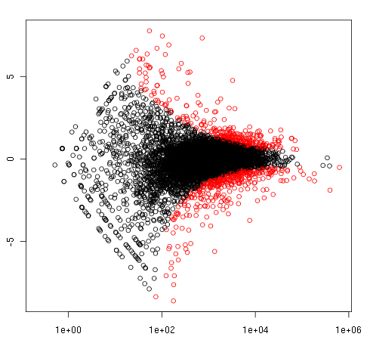
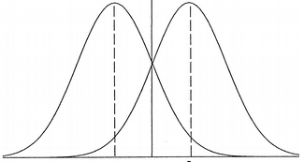
Differential expression (Sleuth)
WWPG 22
Measurement of the difference in expression over:
time, i.e., life stage – juvenile vs adult
space, eg. tissue – gut vs muscle
response to environment, i.e. exposure to drug vs not
etc.
Sleuth
Works on kallisto counts tables
Analyze if the abundances estimated by kallisto are statistically significant between the two conditions.
gene A, condition 1
gene A, condition 2
Log fold change
M
Normalised read counts
Log average expression level
Differential expression (Sleuth)
Fold change: how much a quantity ranges between 2 conditions
Notes:
Differential expression analysis means taking the normalised read count data and performing statistical analysis to discover quantitative changes in expression levels between experimental groups.
For example, we use statistical testing to decide whether, for a given gene, an observed difference in read counts is significant, that is,
whether it is greater than what would be expected just due to natural random variation.
There are different methods for differential expression analysis such as edgeR and DESeq based on negative binomial (NB) distributions or
baySeq and EBSeq which are Bayesian approaches based on a negative binomial model.
It is important to consider the experimental design when choosing an analysis method.
Sleuth takes kallisto output and determine in each case if the difference between 2 conditions is statistically significant
For this it considers both the fold change, (that is the quantity of changes between the two conditions) and the pvalue allowing to filter only those genes that show differences over or below a threshold.
While some of the differential expression tools can only perform pair-wise comparison,
others such as edgeR, limma-voom, DESeq and maSigPro can perform multiple comparisons.

Slide 17
Fold Change & adjusted p value
FOLD CHANGE (b value)
Describes the ratio between 2 values
Log2 FC (log2(cond1/cond2)
FC=2 (Log2FC=1) A is twice B
FC=0.5 (Log2FC=-1) A is half B
Adjusted P value (q value)
p < 0.05 5% chance of not being DE
An RNASeq is an paralel evaluation of multiple hypothesis (thousands of variables analyzed together).
Correct for multiple testing.
Notes:
Differences in the median values between replicates.
Variance between replicates can tell if the replicate values are different.
DE software work on counts…
Size of the difference in comparison to the variance that tells if significant or not.
If diff large but variance also large, it might not be significant.

Slide 18
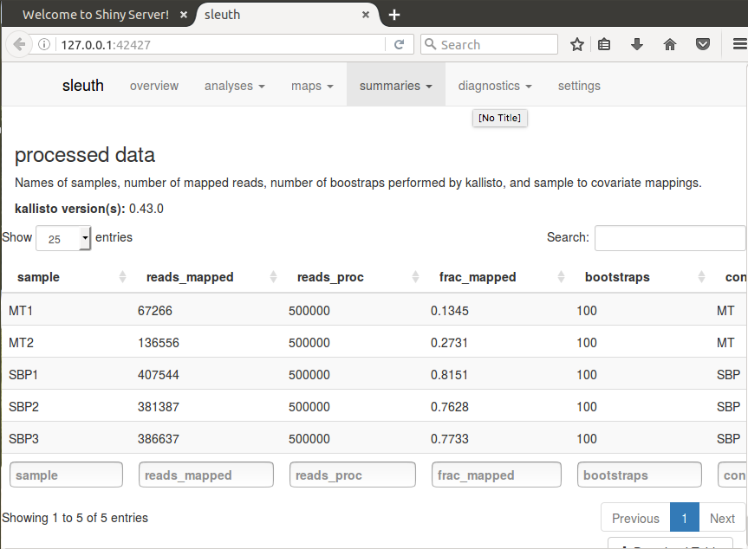
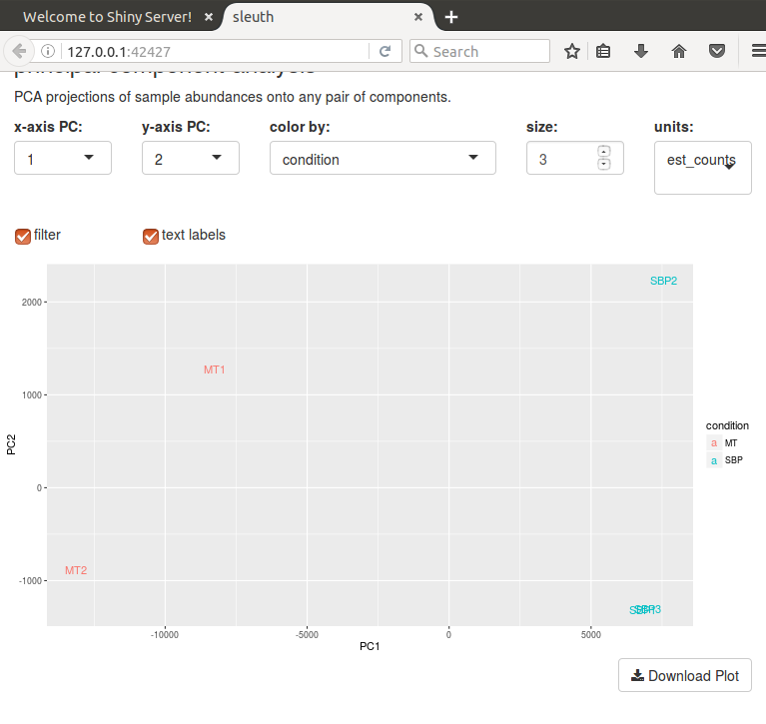
QC with Sleuth
Sleuth
Works on kallisto counts tables
Analyze if the abundances estimated by kallisto are statistically significant between the two conditions.
Allows to evaluate the quality of the datasets in order to compare
WWPG 22
Differential expression (Sleuth)

Slide 19
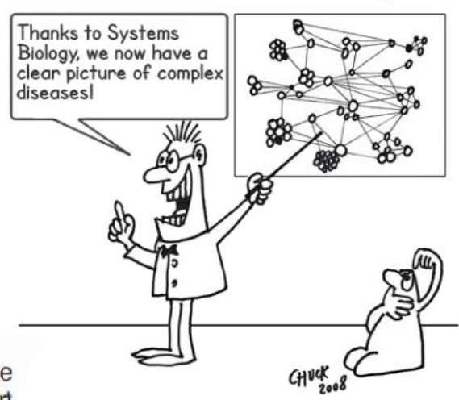
What to do with a gene list
WWPG 22
Are the differences found biologically relevant of noisy data?
Have a hypothesis already? Test it
What are all those genes and what they do?
CLUSTERING
Clustering genes by expression (genes commonly regulated or biological signatures of a condition)
FUNCTIONAL ANOTATION ENRICHMENT
Analyze by GO term/pathway analysis (GSEA, TopGO, InnateDB, Ingenuity Pathway Analysis etc.)
If available, overlay datasets on essentiality, populations, mutations, Pfam domains, chromosomal location, expression, proteome…
(Work through list, Google, read papers… ) ….
then make a hypothesis about what genes are interesting and why. Can you test/explore this further bioinformatically?
Design the next wet lab experiment.

Slide 20
Today´s exercises
Evaluate effects of vector transmission on malaria parasites
Parasites transmitted by mosquitoes are less virulent than those obtained from serially blood passages
ARE THEY DIFFERENT FROM THE TRANSCRIPTIONAL POINT OF VIEW?
Map expression data of the murine Plasmodium species P. chabaudi
View and compare multiple BAM files in Artemis
Identify differentially expressed genes
Use Sleuth to check data quality and interpret results
WWPG 22
Spence et al. (2013).,
Notes:
In this module we will address the effect of vector transmission on gene expression of the malaria parasite.
Figure 1A shows the malaria life cycle, the red part highlighting the mosquito stage.
Figure 1B shows the difference in virulence, measured by blood parasitemia, between mosquito-transmitted and serially blood passaged parasites.
Is the transcriptome of a mosquito-transmitted parasite different from one which has not passed through a mosquito?
The key reason for asking this question is that parasites which are transmitted by mosquito are less virulent in mice than those which are serially blood passaged in the laboratory.
While mosquito transmitted and serially blood passaged parasites have exactly the same set of genes, perhaps they are using those genes differently.
The data in this exercise, as well as figures 1B and 1C are taken from Spence et al. (2013)., published by Springer Nature [https://www.nature.com/articles/nature12231]

Slide 21
Tools for differential expression
SITES
RNASEQ BLOG (www.rna-seqblog.com)
TOOLS
Tuxedo suite (University of Maryland Center for Bioinformatics and Computational Biology)
Original pipeline: Bowtie (mapping), Tophat2, Cufflinks, CummeRbund
New pipeline (2016): HiSat2 (mapping), Stringtie (quant. transcripts), Ballgown (DE R package)
R packages: DEseq2 , EdgeR, limma – can analyse output of Cufflinks/Stringtie
Webpackage: degust - RNA-seq exploration, analysis and visualisation
Pseudoaligners: Kallisto/sleuth
REFS
Martin, J., Wang, Z. (2011) Next-generation transcriptome assembly. Nat Rev Genet 12, 671–682. https://doi.org/10.1038/nrg3068
Pertea et al. Transcript-level expression analysis of RNA-seq experiments with HISAT, StringTie and Ballgown. Nat Protoc 11, 1650–1667 (2016). https://doi.org/10.1038/nprot.2016.095
Conesa et al. (2016) A survey of best practices for RNA-seq data analysis. Genome Biol 17, 13. https://doi.org/10.1186/s13059-016-0881-8
Stark, R., Grzelak, M. & Hadfield, J. (2019). RNA sequencing: the teenage years. Nat Rev Genet 20, 631–656 https://doi.org/10.1038/s41576-019-0150-2
Westermann, A.J., Vogel, J. Cross-species RNA-seq for deciphering host–microbe interactions. Nat Rev Genet 22, 361–378 (2021). https://doi.org/10.1038/s41576-021-00326-y
NOTE: many packages require raw counts for analysis, not FKPM/TPM, as they model dispersal of coverage and normalise across whole genome/transcriptome. Be careful to read/understand specific requirements per tool

